Slide 1


CEP Web Dev 3
Introduction to JS
tinkercademy.com

Slide 2

Schedule
About you, about us, and what is the Internet?
Inspecting the Web
Making our own webpages with CodePen
HTML
CSS & Animations
Javascript
jQuery
Never Gonna Give You Up Generator

Slide 3
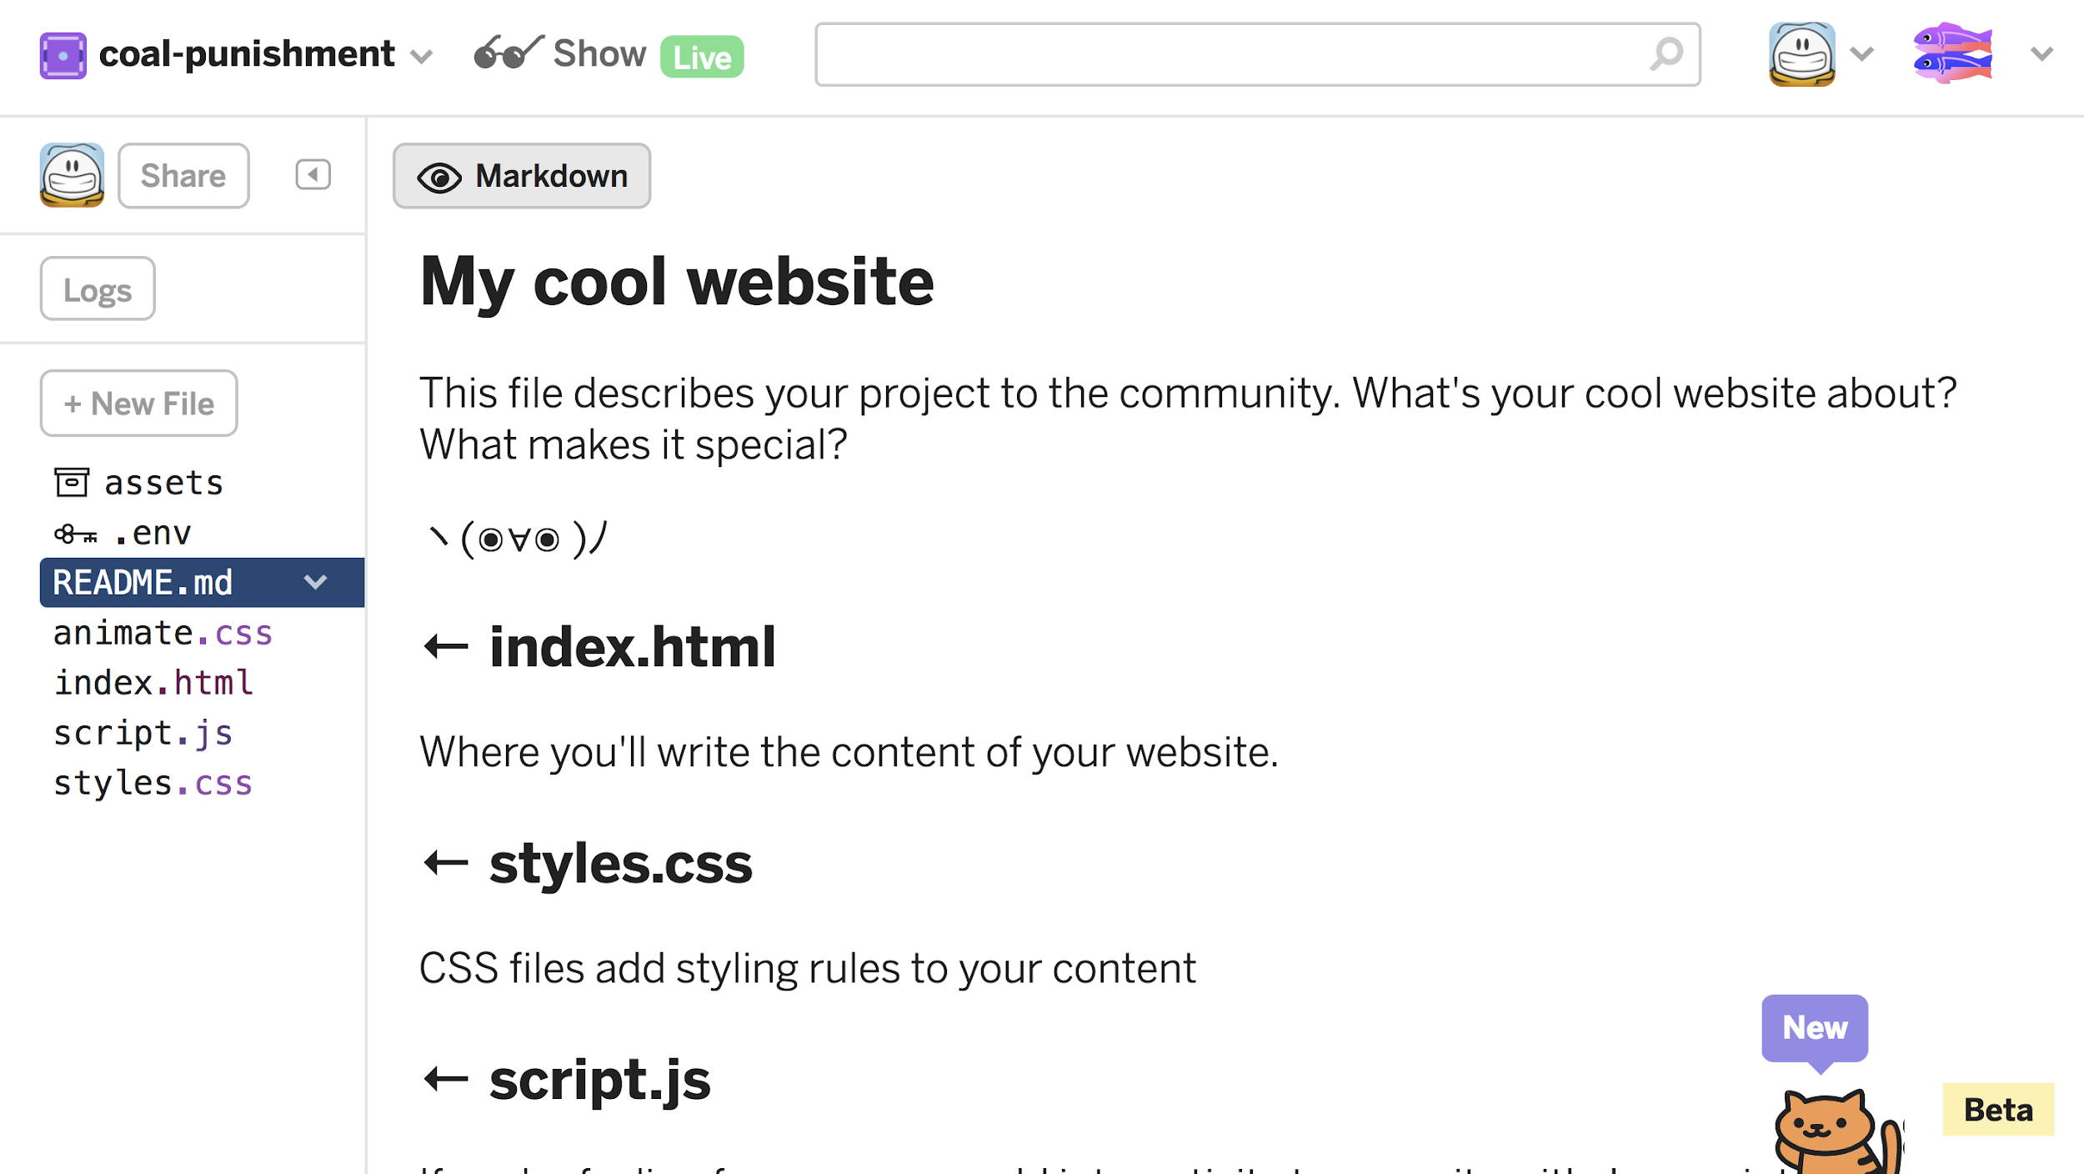
Let’s Use Glitch
Glitch.com. Why?
Supports image uploads through a CDN
Close to “real” development environment
Supports Node out of the box
Has a cat in the bottom right corner
Free

Slide 4
JavaScript
Not Java, but named similarly to ride on its popularity. It’s like calling a condominium Rafflesia because it’s next to… oh wait.

Slide 5
HTML-CSS-JS
HTML for structure
CSS for presentation
JS for interaction on the front-end
JavaScript is used for many things on and off the web
Back-end programming with Node.js
Writing text editors like Atom
ProcessingJS for visualisation & animation
An operating system, for some reason
Writing mobile apps with React Native
Letting people write more JavaScript, with CodePen (and others)

Slide 6
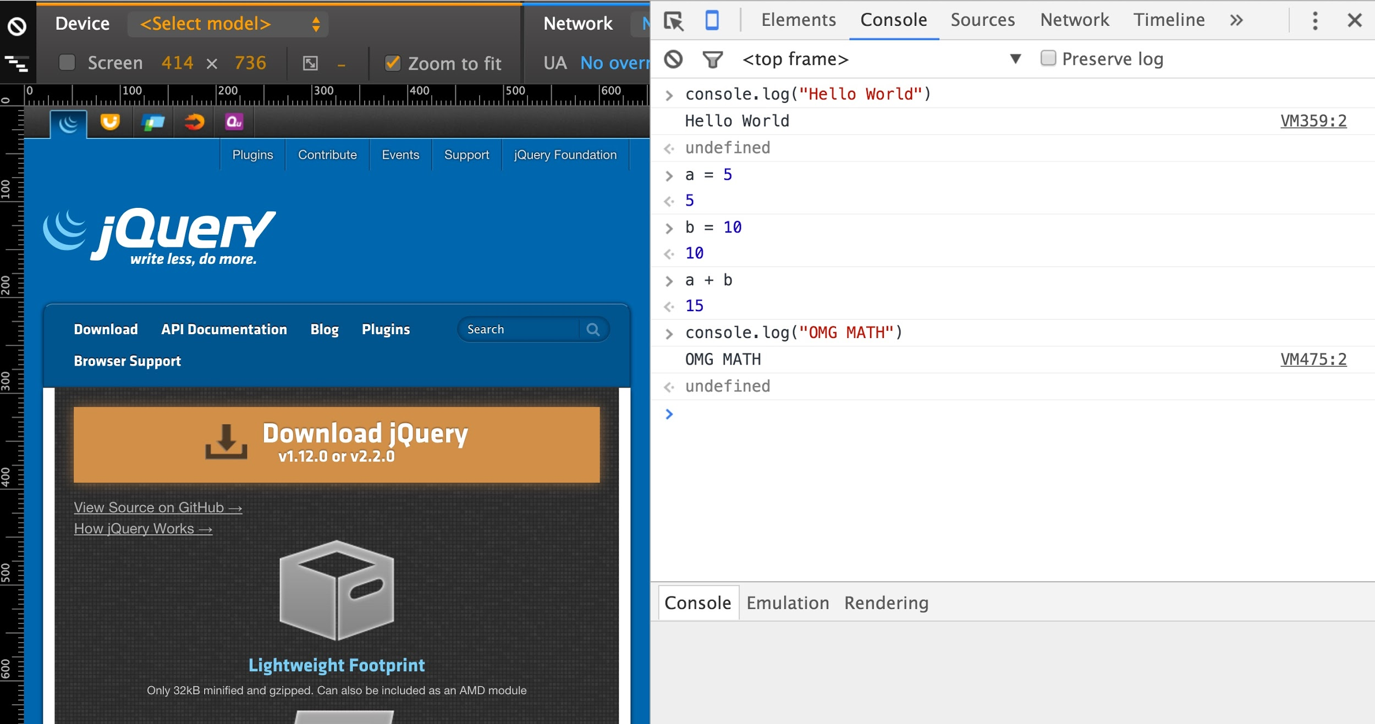
JavaScript in the Inspector
Back to the Chrome Inspector—look at the Console.

Slide 7
Let’s try some JS
Open any webpage, bring up the Inspector, and type these:
> var num1 = 1
> var num2 = 2
> var sum1 = num1 + num2
> console.log(sum1)
> var txt1 = "Hello, I am a potato"
> var txt2 = txt1 + txt1
> console.log(txt2 + sum1)
What’s going on?

Slide 8
Let’s try some JS
Go to jquery.com, and type these into the console:
> document.getElementsByTagName("h2")
> document.getElementsByTagName("h2")[0]
> document.getElementsByTagName("h2")[0].innerHTML
> document.getElementsByTagName("h2")[0].innerHTML = "I enjoy eating potatoes"
We’re using JavaScript to manipulate the DOM, i.e. the downloaded webpage. There are many document-related functions—try typing document.get, then pressing tab.

Slide 9
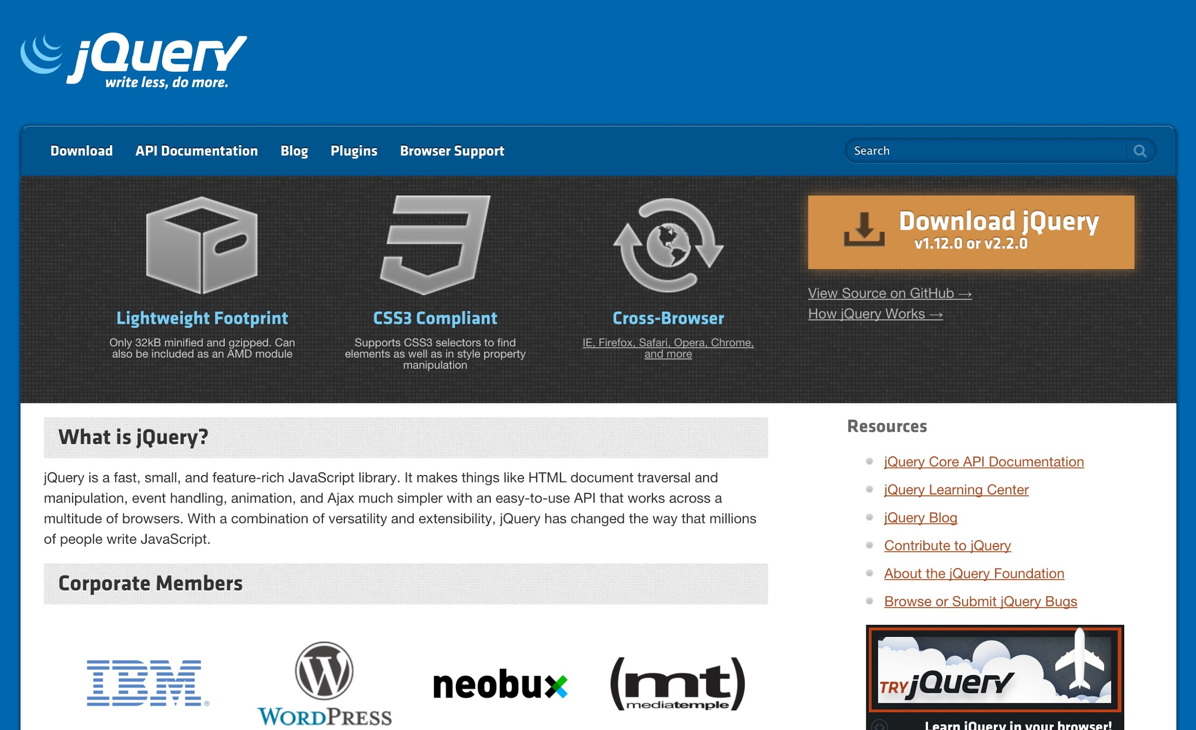
jQuery

Slide 10
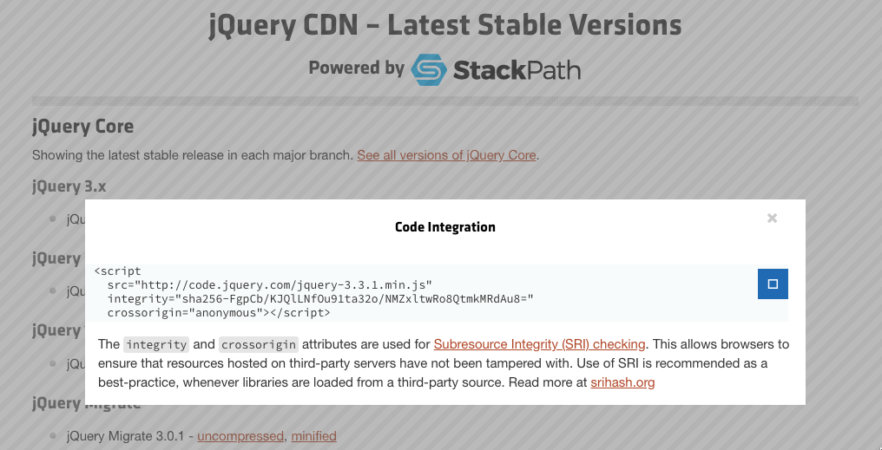
Add jQuery
Go to the jQuery CDN: http://code.jquery.com/
Click on the first “minified”
Copy the link
Paste this into your HTML file, in <head>

Slide 11
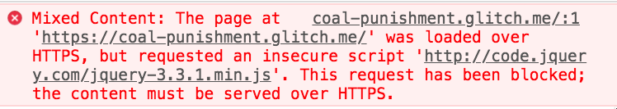
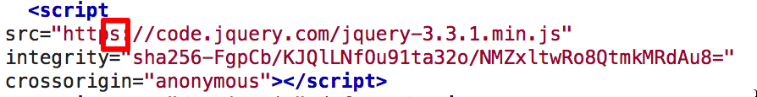
Error?
If your website is loaded with HTTPS, your jQuery should also be loaded with HTTPS
Change to:

Slide 12
Easier Selecting with jQuery
$('your selector here') will select the element <your selector here>
$('#itemID') selects the element with ID itemID
$('.classID') selects the elements with class classID
To get the first, use $('.classID')[0]
Go to a site with jQuery enabled, e.g. www.jquery.com (obviously). Try some selectors!
> $('#container')
> $('.menu-item')
> $('.menu-item')[0]

Slide 13
What to do with selections?
Hide and show:
> $('#container').hide();
> $('#container').show();
Change its CSS:
> $('#container').css('background-color', 'red');
Animate changes:
> $('#container').fadeOut(200);
> $('#container').fadeIn(500);
> $('#container').slideUp(200);
> $('#container').slideToggle();

Slide 14
Making things happen
You don’t expect your users to open up their consoles to type stuff in!
You can add an onclick attribute to a link with a blank href (#):
<a href="#" onclick="runThis()">Run this!</a>
Then in your JS, add a function with what you want to happen:
var runThis = function() {
$('#container').hide();
}

Slide 15
Making things happen at start
Sometimes, you want things to happen after the page finishes loading.
To do this, add this to your JS:
$(function() {
// put your code here, e.g.
alert("Hello! Your page is done!");
});

Slide 16
Summary
Add onclick="functionName()" as an attribute to your <button> or <a> tag
Add a new function to your JavaScript, using that same functionName
var functionName = function() {
// do stuff here
}
Use your selectors and functions to do things!
Here’s an example of toggling with some logic and a variable.

Slide 17
Exercise
Spruce up your profile page with some interactivity!
Make things animate when clicked on. If you combine this with Animate.css, you can simply use jQuery’s addClass to include animated to get something to move.

Slide 18
Using Your Powers for Evil

Slide 19
Advanced Exercise
Make a Rickroll spammer. One click on a button will bring up:
A video of “Never Gonna Give You Up” in the middle of the page
Hint: You can have it already on your page, but hidden, and show it only when the button is pressed
Get it to autoplay
Hint: use jQuery’s attr() to change the iframe’s src attribute
Generate a new video every couple of seconds, and append it
Hint: jQuery setInterval(), clone(), insertAfter()
Place it somewhere random on the page
Hint: use position: absolute for your CSS, and adjust the top and left with random numbers (Google)
CHAOS

Slide 20
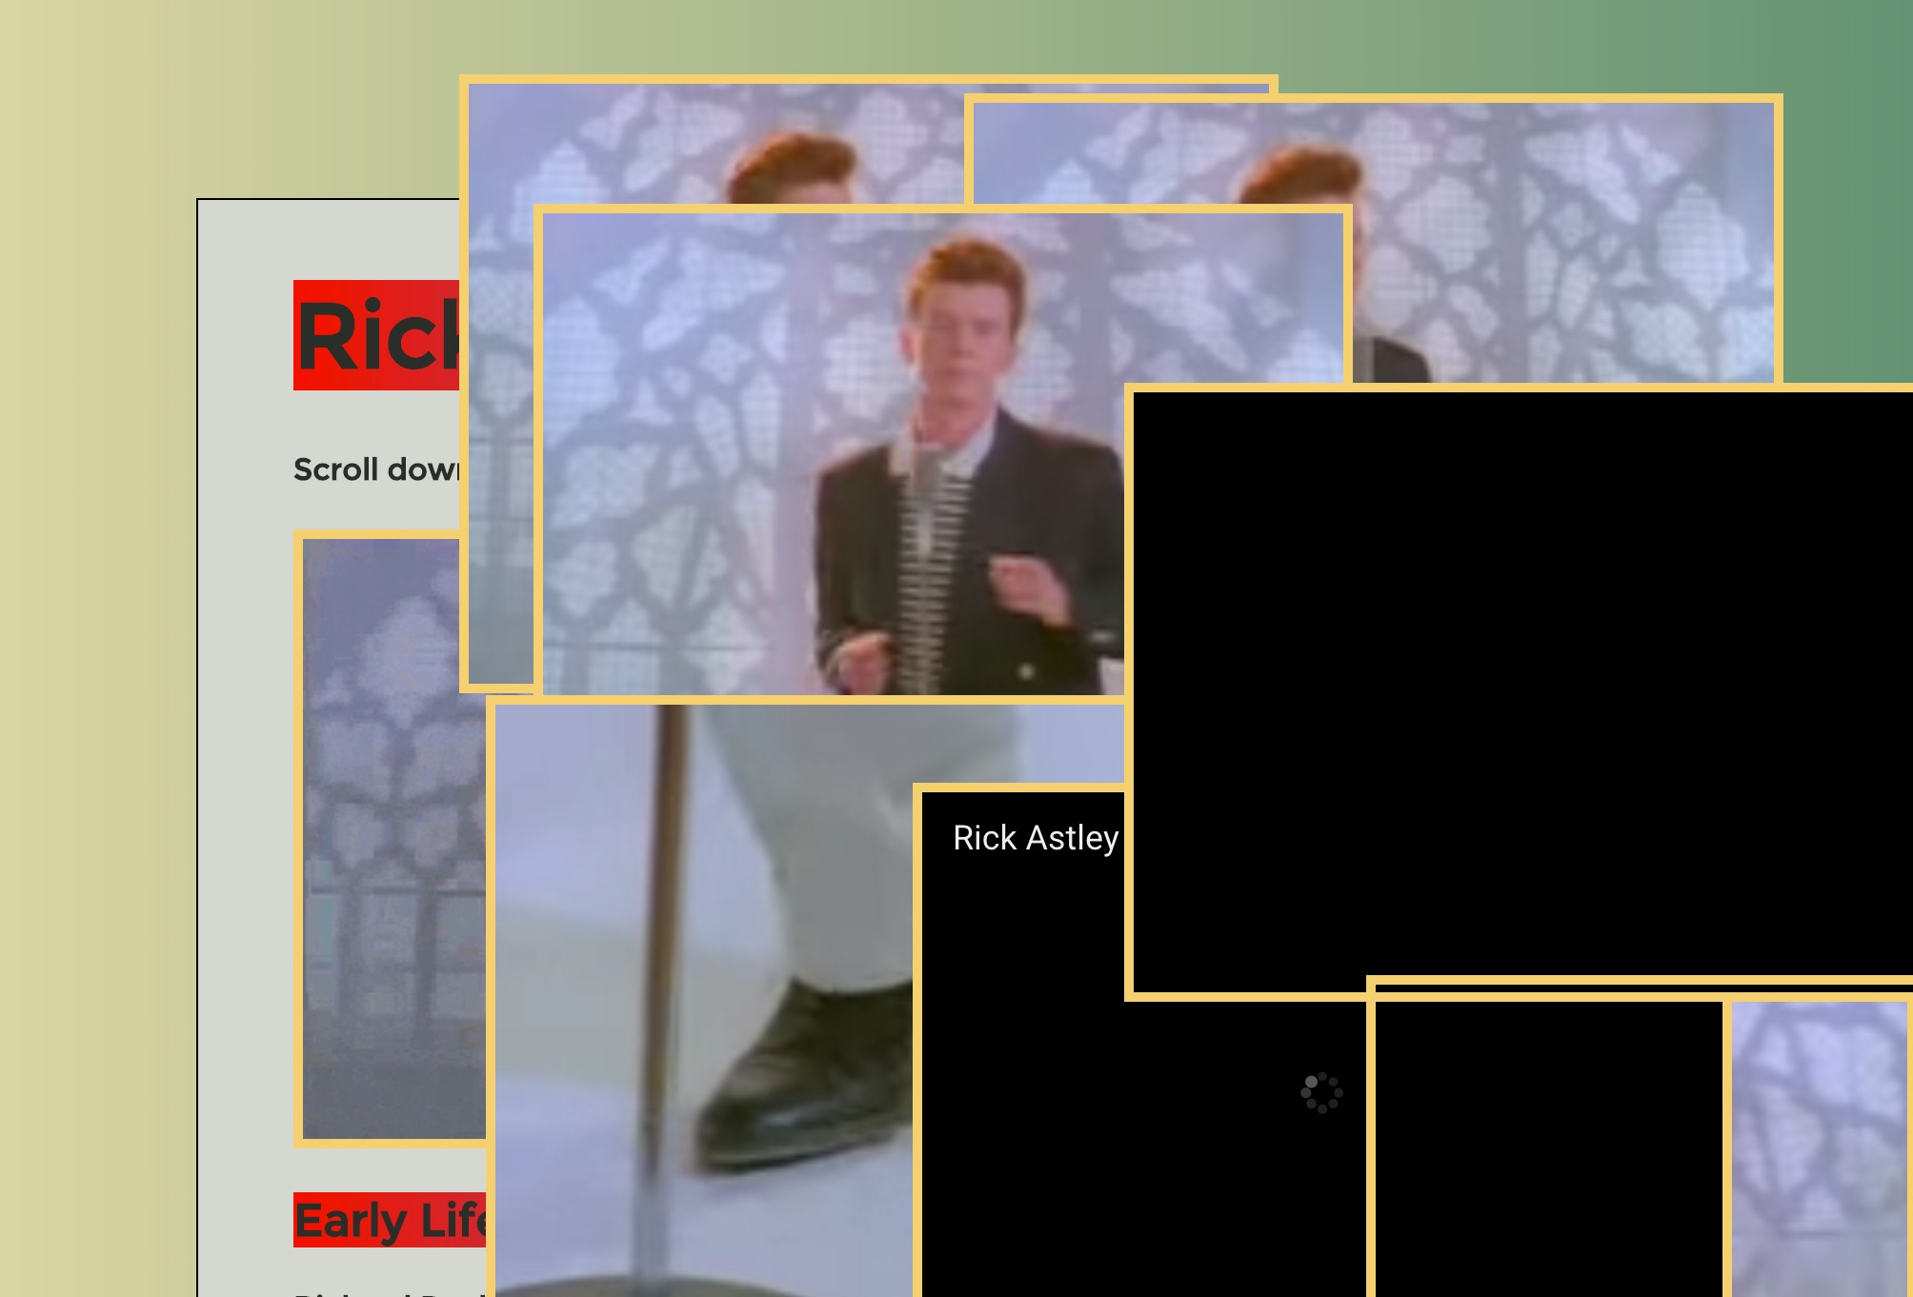
Agggh (GIF demo)

